Slide 1
MAGICAL 1.0: An Open-Source Fully-Automated AMS Layout Synthesis Framework Verified With a 40-nm 1GS/s ΔΣ ADC
Hao Chen*, Mingjie Liu*, Xiyuan Tang*, Keren Zhu*, Abhishek Mukherjee, Nan Sun, and David Z. Pan (*: Equal contribution)
The University of Texas at Austin

Slide 2
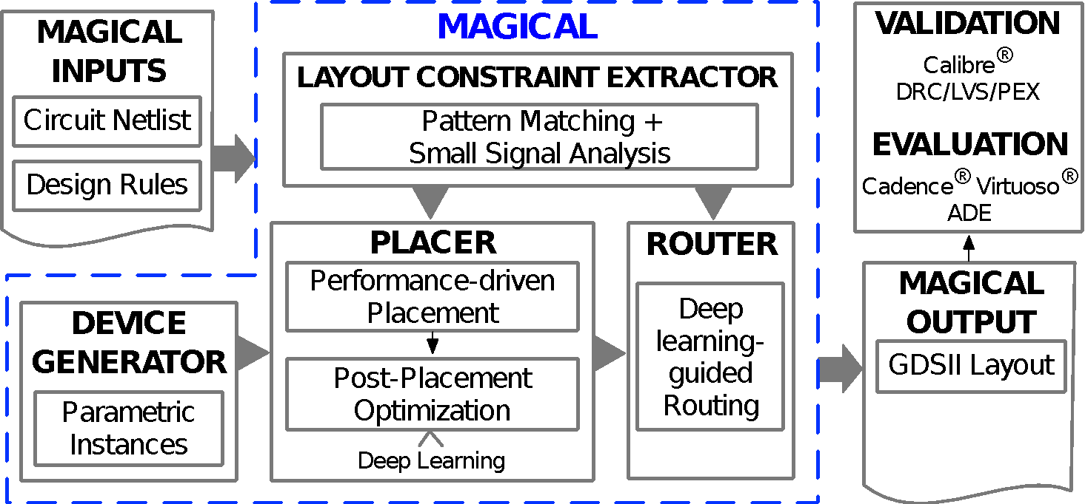
MAGICAL: MAchine Generated IC Analog Layout

Slide 3
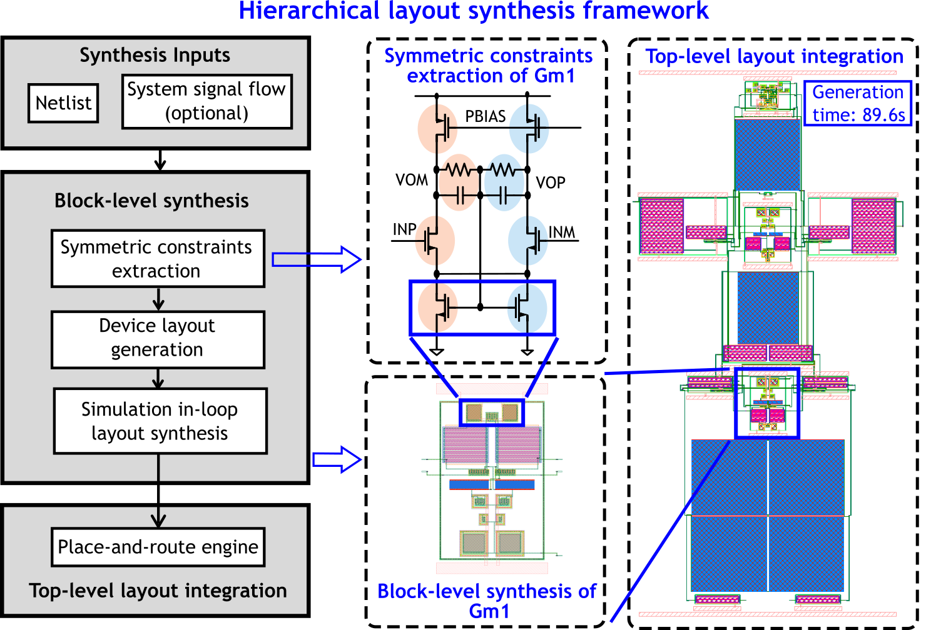
MAGICAL 1.0: Hierarchical Framework

Slide 4
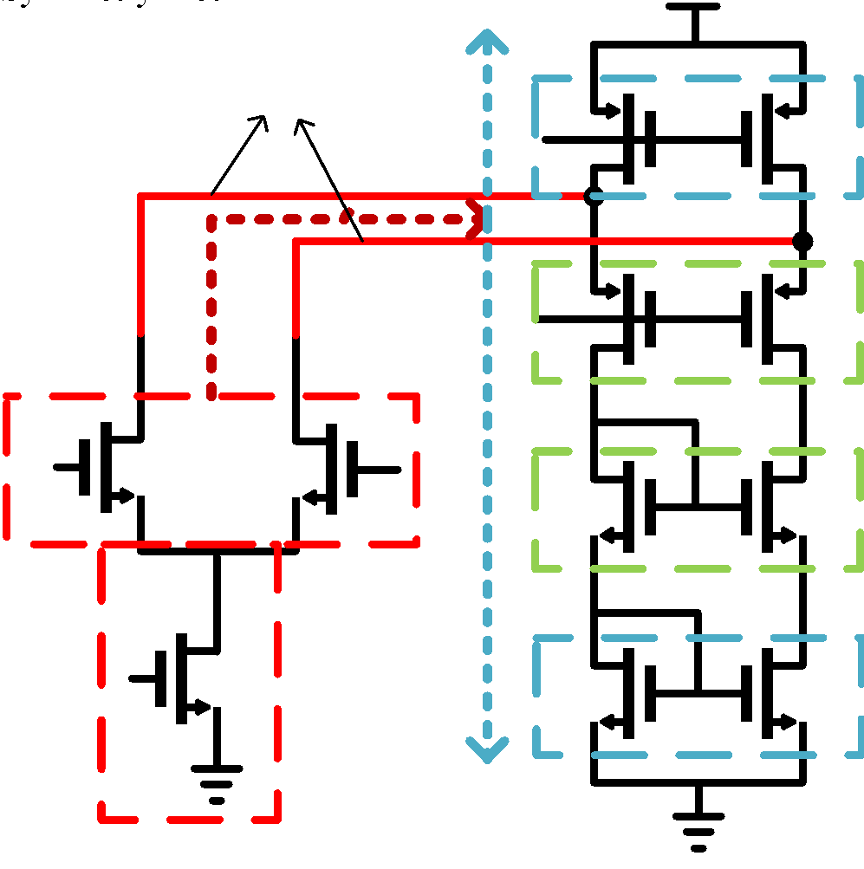
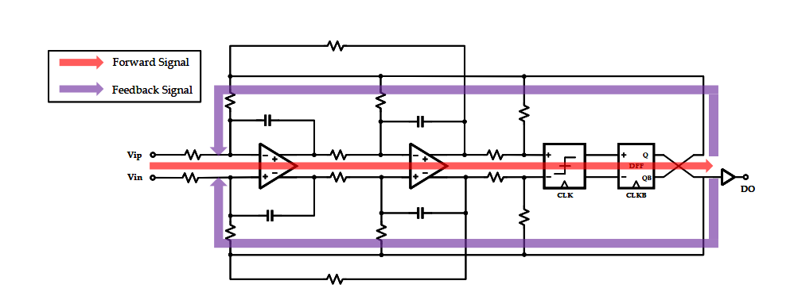
MAGICAL 1.0: Constraint Generation
Pattern detection for building block symmetry [Xu+, ICCAD'19]
Graph similarity for system symmetry constraint [Liu+, ASPDAC'20]
Customizable signal-flow constraints
Symmetry nets
Building block symmetry
System-level constraints

Slide 5
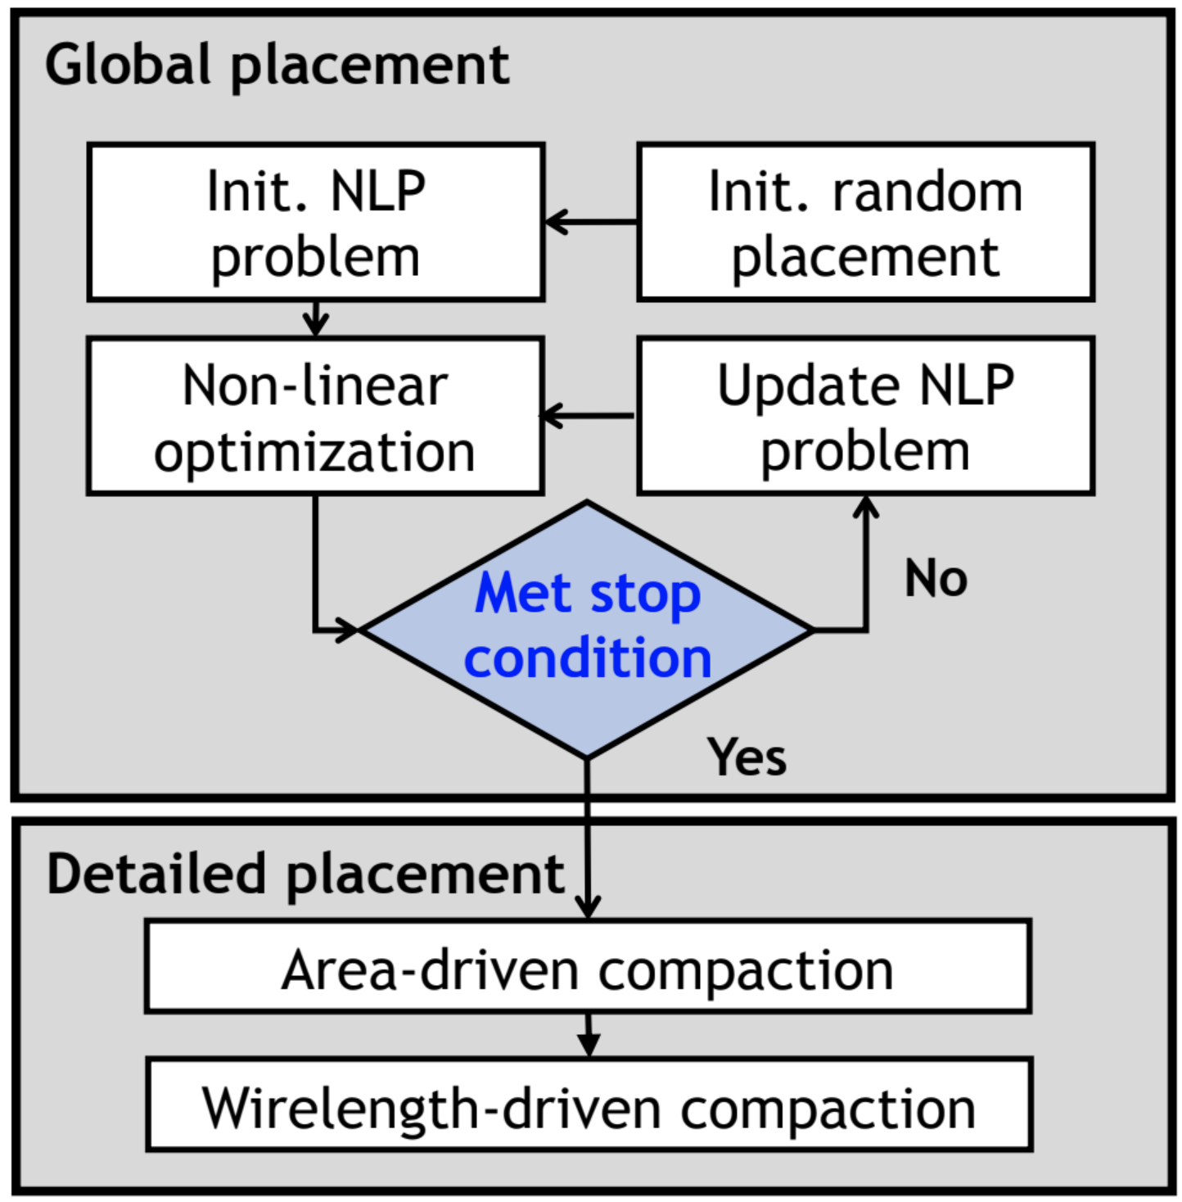
MAGICAL 1.0: Placer
Nonlinear programming-based global placement
Linear programming-based detailed placement
Using system signal flow to guide placement for mixed-signal placement
[Zhu+, ICCAD'20]

Slide 6
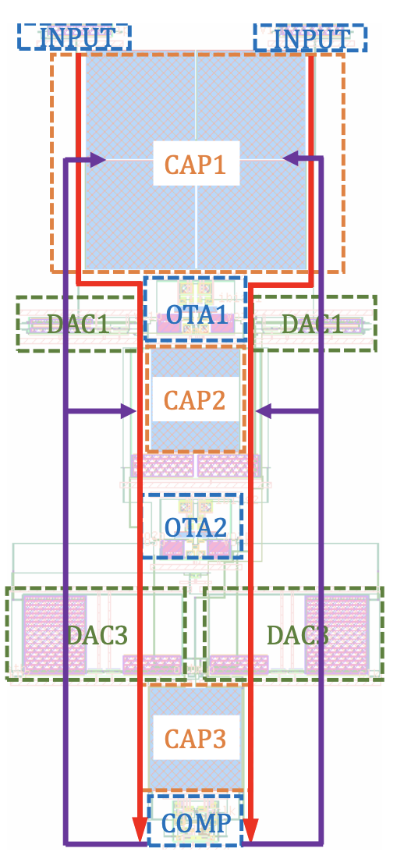
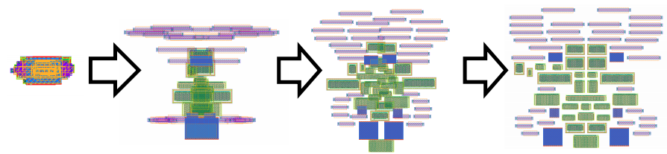
MAGICAL 1.0: Placer
Consider regularity of system signal flow in placement
Improved numerical optimization kernel
Better post-layout simulation performance and placement metrics

Slide 7
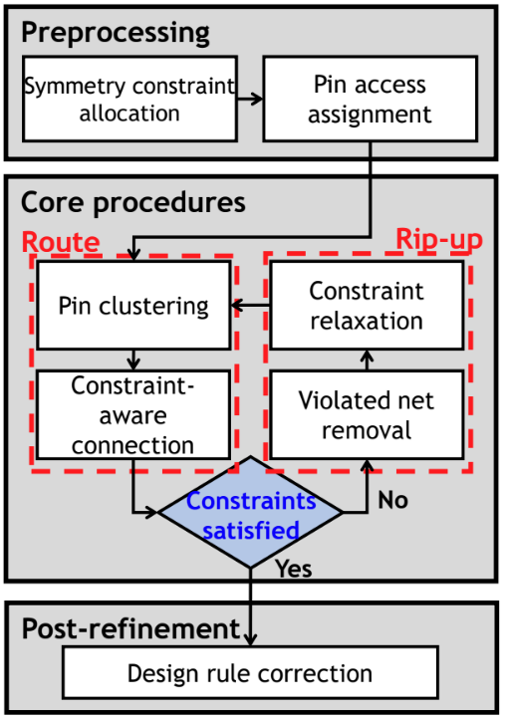
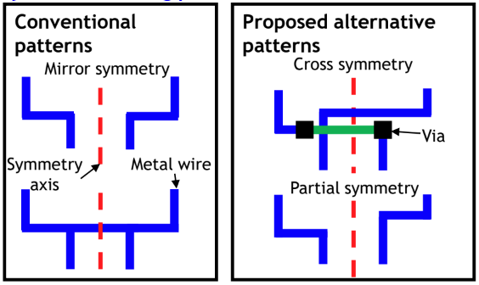
MAGICAL 1.0: Router
Grid-based routing kernel w/ DRC handling
New symmetry routing patterns
Special power/ground routing
[Chen+, ICCAD'20]

Slide 8
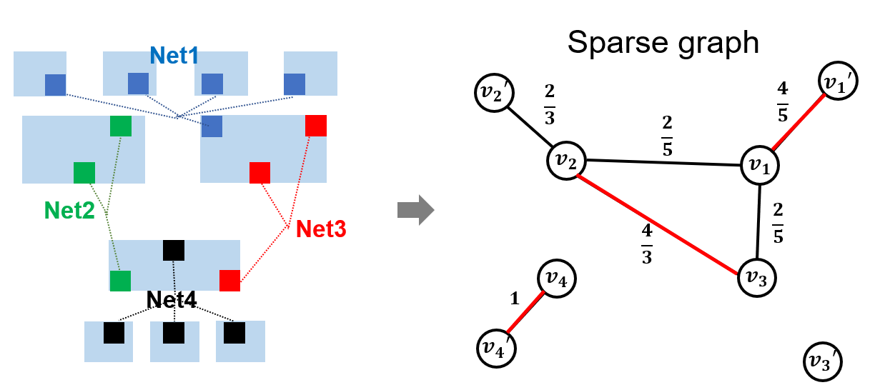
MAGICAL 1.0: Router
Multiple vias and various wire widths for voltage drop consideration
Symmetry constraint allocation
Maximize the overall potential routing symmetry (Weighted graph matching)
Pin access assignment
Pin access assignment
Access point
(gate)
Gate
Drain
Access point
(drain)
Invalid access
point
Access point
(source)
Source

Slide 9
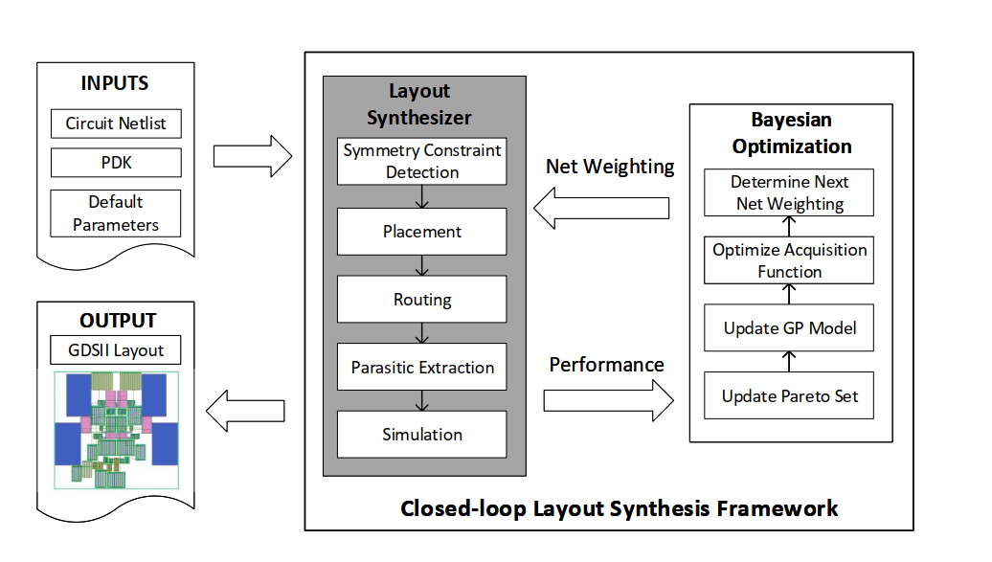
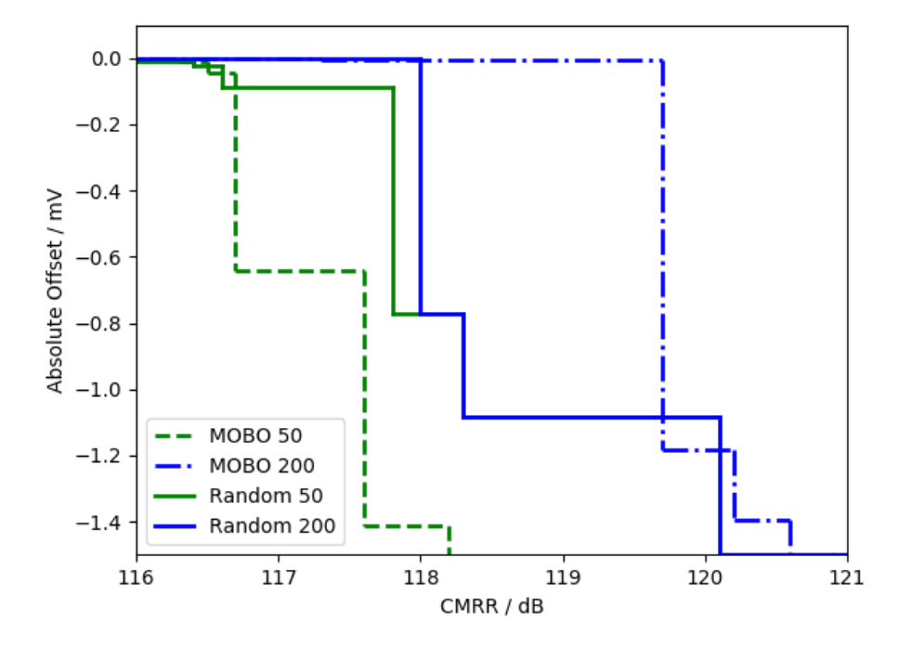
Simulation in the Loop
Simulation-in-loop: use simulation results on building block level circuits as the feedback to the MAGICAL P&R
Intelligent performance prediction will reduce #simulations
[Liu+, DAC'20]

Slide 10
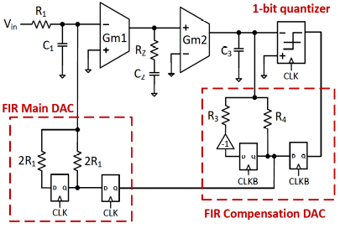
MAGICAL 1.0: 3rd-order CTDSM Demo
1GS/s 3rd-order high-performance continuous time ΔΣ modulator
State-of-the-art performance, originally published in IEEE SSC-L'20
Include various sub-block types
Notes:
Three integrators: One passive, two active
Two FIR-based feedback DACs
One comparator
Digital logic

Slide 11
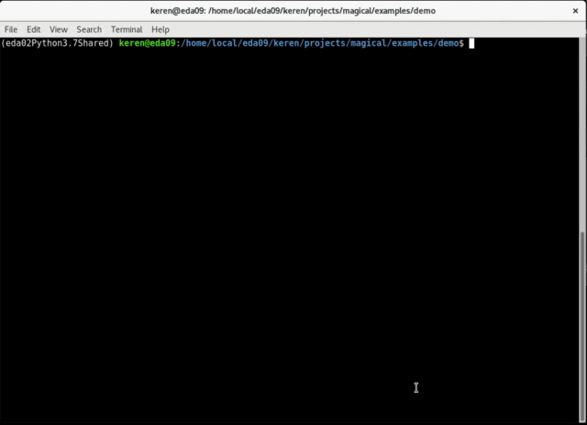
MAGICAL 1.0: 3rd-order CTDSM Demo
*For demo purpose, simulation in the loop not included.

Slide 12
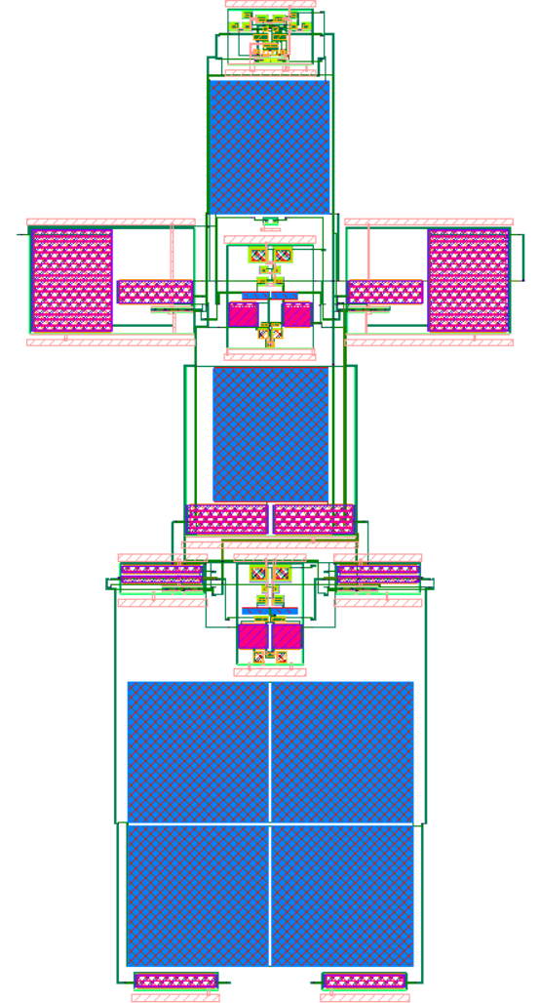
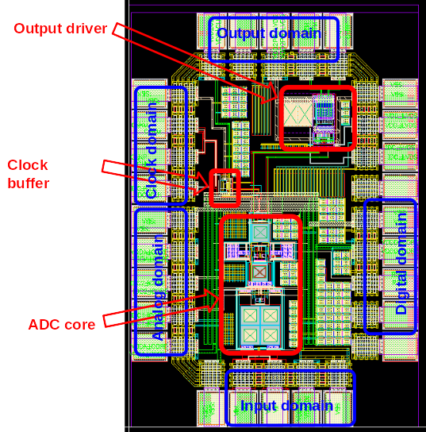
MAGICAL 1.0: Fully Synthesized ADC Core
After ~90 seconds….
Core area: 22,000 um²
Tape-out with manually designed peripherals (buffer, driver, PADs)
ADC Core

Slide 13
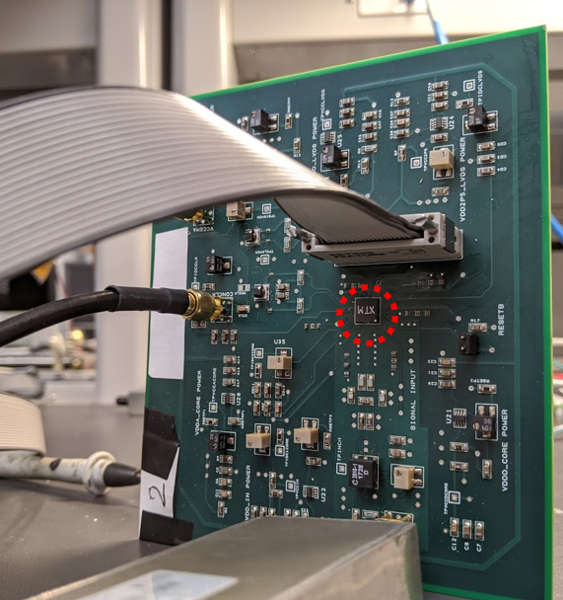
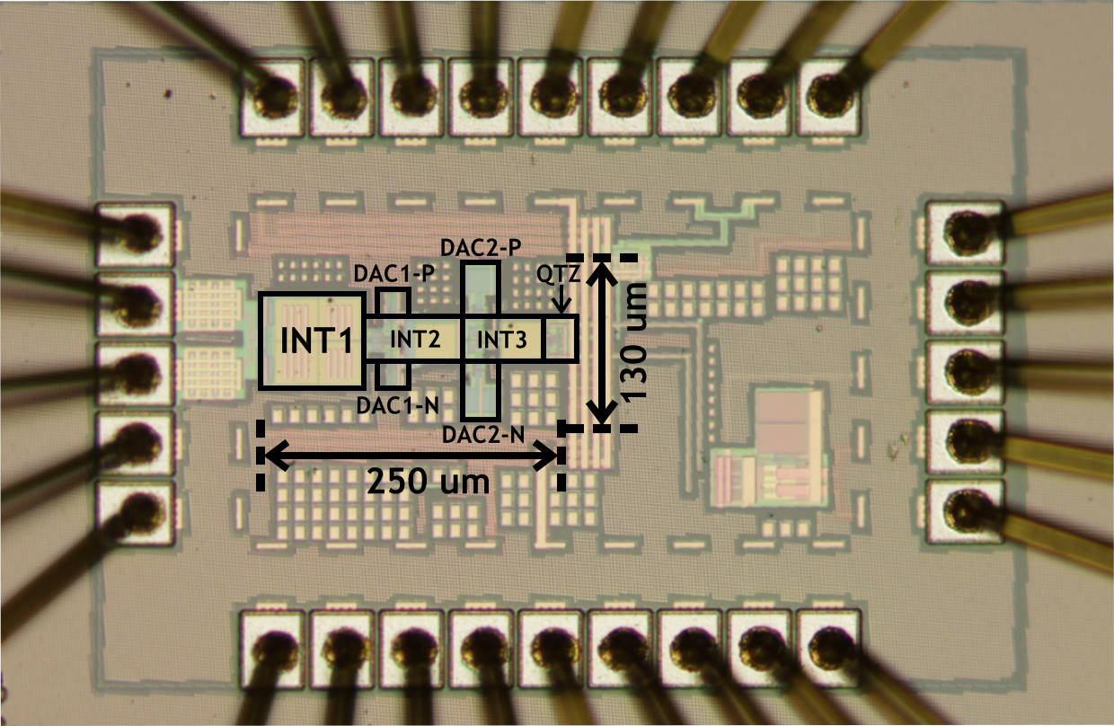
MAGICAL 1.0: Measurement
CTDSM ADC chip under TSMC40 technology
PCB board
Chip micrograph of the synthesized CTDSM

Slide 14
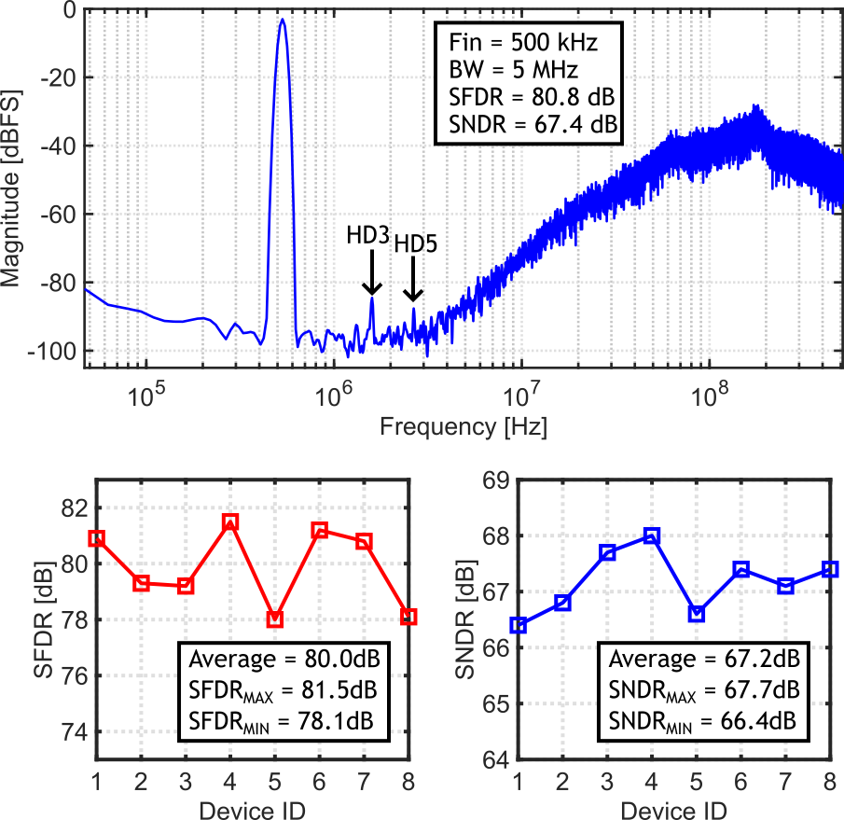
MAGICAL 1.0: Measurement
Fs: 1GHz
BW: 5MHz
SNDR: 67.4dB
SFDR: 80.8dB

Slide 15
MAGICAL 1.0: Measurement
Stable performance across 8 samples.

Slide 16
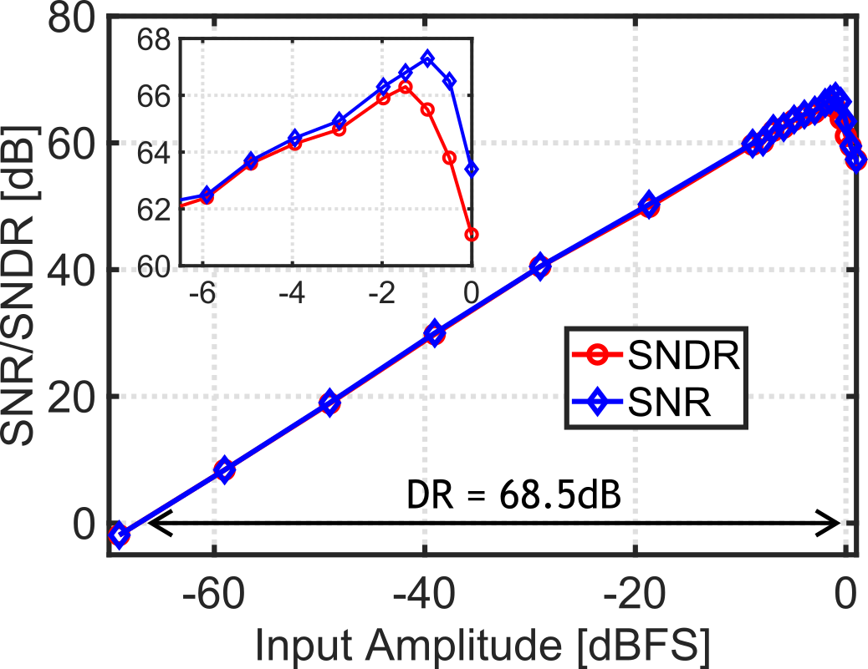
MAGICAL 1.0: Measurement
DR: 68.5dB

Slide 17
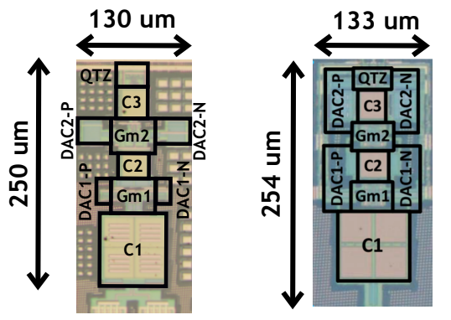
Comparison with SOTA CTDSM ADCs
Only require signal flow information
Comparable layout with manual design [SSCL ’20 Mukherjee]
MAGICAL 1.0
Manual

Slide 18
Comparison with SOTA CTDSM ADCs
Fully-synthesized layout
 | JSSC-16 Weng | SSCL-20 Mukherjee¹ | CICC-19 Li | This work¹
Architecture | CTΔΣM | CTΔΣM | VCO-CTΔΣM | CTΔΣM
Layout synthesized | ✖ | ✖ | ✔ | ✔
Universal synthesis framework | N/A | N/A | ✖ | ✔
Hierarchical flow | N/A | N/A | ✖ | ✔
Constraint generation | N/A | N/A | ✖ | ✔
¹: same schematic
Notes:
MAGICAL 1.0 layout compares well with manual layout (SSCL'20) in terms of power, performance, and area (runtime O(min) vs. O(month)

Slide 19
Comparison with SOTA CTDSM ADCs
Comparable results with other SOTA CTDSM ADCs
 | JSSC-16 Weng | SSCL-20 Mukherjee¹ | CICC-19 Li | This work¹
Architecture | CTΔΣM | CTΔΣM | VCO-CTΔΣM | CTΔΣM
Order | 4th | 3rd | 1st | 3rd
Area [mm²] | 0.1 | 0.034 | 0.01 | 0.033
Fs [MHz] | 320 | 1024 | 600 | 1024
Power [mW] | 4.2 | 0.79 | 1.08 | 0.77
BW [MHz] | 10 | 5 | 4 | 5
SNDR [dB] | 74.4 | 65.6 | 68.8 | 67.4
FoMw [fJ/c-s] | 49.3 | 51 | 60 | 40.2
FoMs [dB] | 174.5 | 163.6 | 164.3 | 165.5

Slide 20
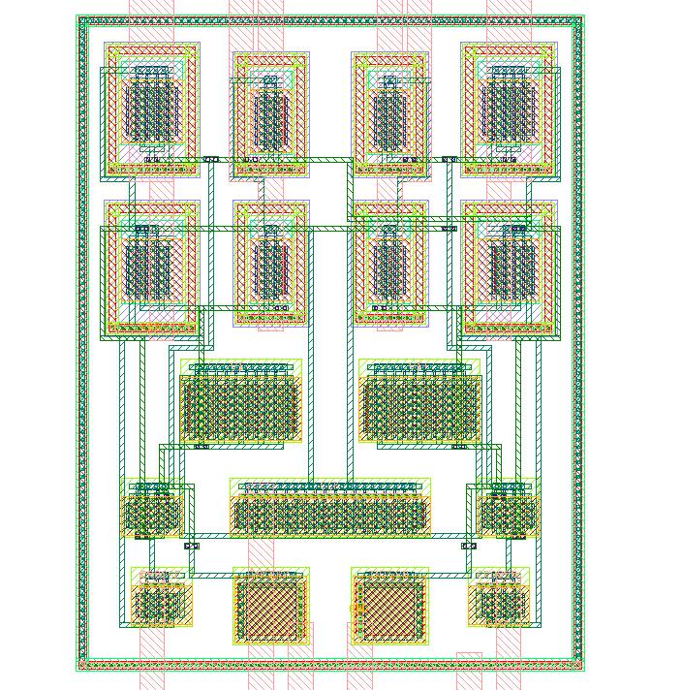
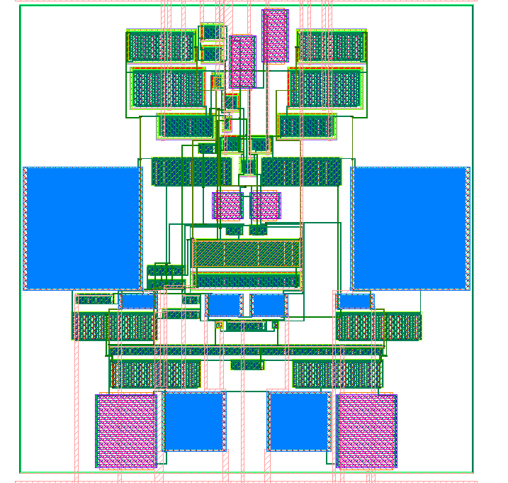
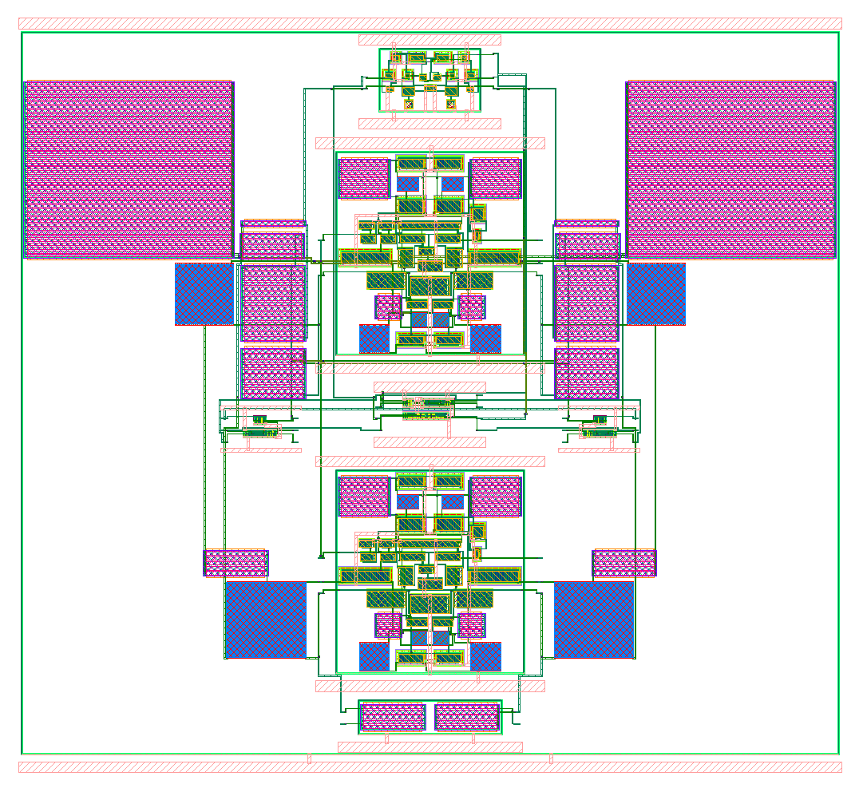
MAGICAL 1.0: Other Circuits
Comparator
Inverter-Based Feed-Forward OTA
2nd-Order CTDSM

Slide 21
MAGICAL 1.0: Public Release
Open-sourced MAGICAL 1.0 (under BSD-3 license), https://github.com/magical-eda/MAGICAL with key updates:
Push-button, no-human-in-the-loop (can take user constraints too)
End-to-end analog layout generation from netlist to GDSII
New placement and routing engines
DRC clean, LVS clean
Real-world circuit examples (PDK-stripped)
https://github.com/magical-eda/MAGICAL-CIRCUITS
Open-sourced UT-AnLay dataset and ML model for analog post-layout performance prediction https://github.com/magical-eda/UT-AnLay

Slide 22
Acknowledgements
The authors thank DARPA for supporting this project and TSMC for university shuttle program.
Thank you!
Q & A

